Slide 1

Chapter 3
Data and Signals
3.<number>
Copyright © The McGraw-Hill Companies, Inc. Permission required for reproduction or display.

Slide 2
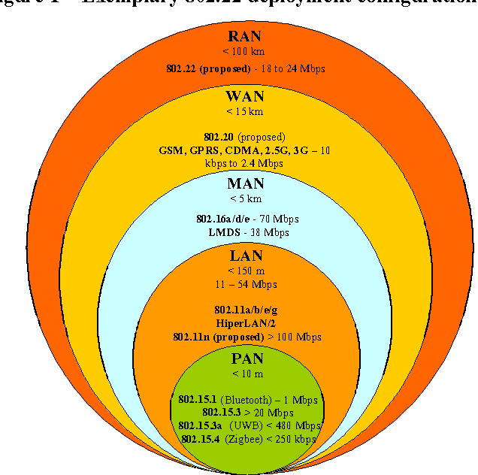
3.<number>

Slide 3
BASIS OF COMPARISON | LAN | MAN | WAN
Expands to | Local Area Network | Metropolitan Area Network | Wide Area Network
Meaning | A network that connects a group of computers in a small geographical area. | It covers relatively large region such as cities, towns. | It spans large locality and connects countries together. Example Internet.
Ownership of Network | Private | Private or Public | Private or Public
Design and maintenance | Easy | Difficult | Difficult
Propagation Delay | Short | Moderate | Long
Speed | High | Moderate | Low
Fault Tolerance | More Tolerant | Less Tolerant | Less Tolerant
Congestion | Less | More | More
Used for | College, School, Hospital. | Small towns, City. | Country/Continent.
3.<number>

Slide 4
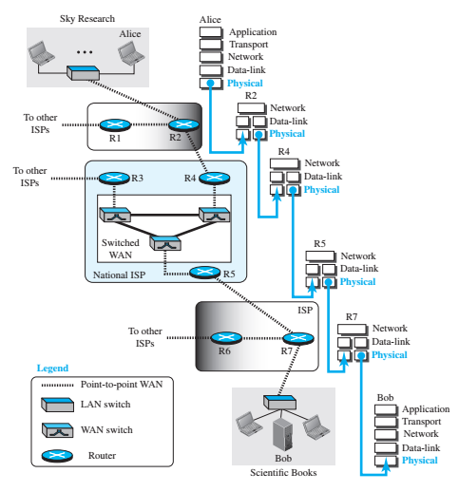
A scientist (Alice) working in a research company, Sky
Research, needs to order a book related to her research from an online bookseller (Bob), Scientific Books.
Transmitted data changes to signal.
3.<number>

Slide 5

Note
To be transmitted, data must be transformed to electromagnetic signals.
3.<number>

Slide 6
3-1 ANALOG AND DIGITAL
Data can be analog or digital. The term analog data refers to information that is continuous; digital data refers to information that has discrete states. Analog data take on continuous values. Digital data take on discrete values.
Topics discussed in this section:
Analog and Digital Data
Analog and Digital Signals
Periodic and Nonperiodic Signals
3.<number>

Slide 7
Note
Data can be analog or digital.
Analog data are continuous and take continuous values.
Digital data have discrete states and take discrete values.
3.<number>

Slide 8
Note
Signals can be analog or digital.
Analog signals can have an infinite number of values in a range; digital signals can have only a limited
number of values.
3.<number>

Slide 9

Figure 3.1 Comparison of analog and digital signals
3.<number>

Slide 10
Analog v/s Digital
Analog
Digital
Used to transmit video and audio signals.
Used when we don’t have large bandwidth.
Higher error rate due to sine property.
Continuous by nature.
Uses curved wave forms.
Can travel short distance.
Amplifiers are used which gives strength to signal but can’t correct the signals.
Analog signals can be used for digital transmission. Eg; Modem sends digital data over analog telephone lines.
Used to transfer (0,1) bits generally for file transfer.
Used when we have large bandwidth.
Low error rate.
Discrete by nature.
Square wave forms.
Can travel long distance.
Repeaters are used to give strength to signal which can also correct signals.
Digital signals can be used for analog transmission. Eg. You tube, Skype transmitting audio video signals using digital signals.

Slide 11
Note
In data communications, we commonly use periodic analog signals and nonperiodic digital signals.
3.<number>

Slide 12
3-2 PERIODIC ANALOG SIGNALS
Periodic analog signals can be classified as simple or composite. A simple periodic analog signal, a sine wave, cannot be decomposed into simpler signals. A composite
periodic analog signal is composed of multiple sine waves.
Topics discussed in this section:
Sine Wave
Wavelength
Time and Frequency Domain
Composite Signals
Bandwidth
3.<number>

Slide 13

Figure 3.2 A sine wave
3.<number>

Slide 14
Example 3.1
The sine wave is the fundamental periodic signal.
A general sine wave can be represented by three parameters:
peak amplitude (A) - the maximum value or strength of the signal over time; typically measured in volts.
frequency (f) - the rate [in cycles per second, or Hertz (Hz)] at which the signal repeats. An equivalent parameter is the period (T) of a signal, so T = 1/f.
phase (φ) - measure of relative position in time within a single period of a signal, illustrated subsequently
3.<number>

Slide 15
Example 3.1
The power in your house can be represented by a sine wave with a peak amplitude of 155 to 170 V. However, it is common knowledge that the voltage of the power in U.S. homes is 110 to 120 V. This discrepancy is due to the fact that these are root mean square (rms) values. The signal is squared and then the average amplitude is calculated. The peak value is equal to 2^{½} × rms value.
Peak Amplitude = 2^{½} × rms
So, what voltage is coming to Indian Home? 250v
What will be the peak amplitude? 350v
3.<number>

Slide 16

Figure 3.3 Two signals with the same phase and frequency,
but different amplitudes
3.<number>

Slide 17
Example 3.2
The voltage of a battery is a constant; this constant value can be considered a sine wave, as we will see later. For example, the peak value of an AA battery is normally
1.5 V.
3.<number>

Slide 18
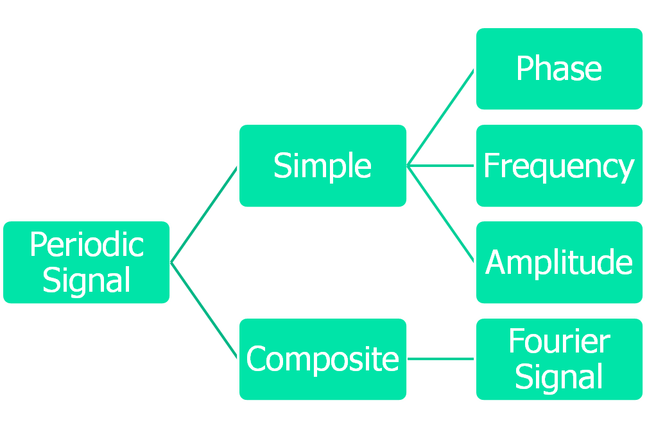
3.<number>

Slide 19

Frequency and Period
Note
Frequency and period are the inverse of each other.
3.<number>

Slide 20

Figure 3.4 Two signals with the same amplitude and phase,
but different frequencies
3.<number>

Slide 21

Table 3.1 Units of period and frequency
3.<number>

Slide 22

Example 3.3
The power we use at home has a frequency of 60 Hz. The period of this sine wave can be determined as follows:
3.<number>

Slide 23
Example 3.4
Express a period of 100 ms in microseconds.
Solution
From Table 3.1 we find the equivalents of 1 ms (1 ms is 10⁻³ s) and 1 s (1 s is 10⁶ μs). We make the following substitutions:.
3.<number>

Slide 24

Example 3.5
The period of a signal is 100 ms. What is its frequency in kilohertz?
Solution
First we change 100 ms to seconds, and then we calculate the frequency from the period (1 Hz = 10⁻³ kHz).
3.<number>

Slide 25
Note
Frequency is the rate of change with respect to time.
Change in a short span of time
means high frequency.
Change over a long span of
time means low frequency.
3.<number>

Slide 26
Note
If a signal does not change at all, its frequency is zero.
If a signal changes instantaneously, its frequency is infinite.
3.<number>

Slide 27
Note
Phase describes the position of the waveform relative to time 0.
3.<number>

Slide 28

Figure 3.5 Three sine waves with the same amplitude and frequency,
but different phases
3.<number>

Slide 29

Figure 3.6 Wavelength and period
3.<number>

Slide 30

Figure 3.7 The time-domain and frequency-domain plots of a sine wave
3.<number>

Slide 31
Note
A complete sine wave in the time domain can be represented by one single spike in the frequency domain.
3.<number>

Slide 32
Example 3.7
The frequency domain is more compact and useful when we are dealing with more than one sine wave. For example, Figure 3.8 shows three sine waves, each with different amplitude and frequency. All can be represented by three spikes in the frequency domain.
3.<number>

Slide 33

Figure 3.8 The time domain and frequency domain of three sine waves
3.<number>

Slide 34
Note
A single-frequency sine wave is not useful in data communications;
we need to send a composite signal, a signal made of many simple sine waves.
3.<number>

Slide 35
Note
According to Fourier analysis, any composite signal is a combination of
simple sine waves with different frequencies, amplitudes, and phases.
3.<number>

Slide 36
Note
If the composite signal is periodic, the decomposition gives a series of signals with discrete frequencies;
if the composite signal is nonperiodic, the decomposition gives a combination of sine waves with continuous frequencies.
3.<number>

Slide 37

Figure 3.9 A composite periodic signal
3.<number>

Slide 38

Figure 3.10 Decomposition of a composite periodic signal in the time and
frequency domains
3.<number>

Slide 39
Example 3.9
Figure 3.11 shows a nonperiodic composite signal. It can be the signal created by a microphone or a telephone set when a word or two is pronounced. In this case, the composite signal cannot be periodic, because that implies that we are repeating the same word or words with exactly the same tone.
3.<number>

Slide 40

Figure 3.11 The time and frequency domains of a nonperiodic signal
3.<number>

Slide 41
Note
The bandwidth of a composite signal is the difference between the
highest and the lowest frequencies contained in that signal.
3.<number>

Slide 42

Figure 3.12 The bandwidth of periodic and nonperiodic composite signals
3.<number>

Slide 43

Example 3.10
If a periodic signal is decomposed into five sine waves with frequencies of 100, 300, 500, 700, and 900 Hz, what is its bandwidth? Draw the spectrum, assuming all components have a maximum amplitude of 10 V.
Solution
Let f_{h} be the highest frequency, f_{l} the lowest frequency, and B the bandwidth. Then
The spectrum has only five spikes, at 100, 300, 500, 700, and 900 Hz (see Figure 3.13).
3.<number>

Slide 44

Figure 3.13 The bandwidth for Example 3.10
3.<number>

Slide 45
Example 3.11
A periodic signal has a bandwidth of 20 Hz. The highest frequency is 60 Hz. What is the lowest frequency? Draw the spectrum if the signal contains all frequencies of the same amplitude.
Solution
Let f_{h} be the highest frequency, f_{l} the lowest frequency, and B the bandwidth. Then
The spectrum contains all integer frequencies. We show this by a series of spikes (see Figure 3.14).
3.<number>

Slide 46

Figure 3.14 The bandwidth for Example 3.11
3.<number>

Slide 47
Example 3.12
A nonperiodic composite signal has a bandwidth of 200 kHz, with a middle frequency of 140 kHz and peak amplitude of 20 V. The two extreme frequencies have an amplitude of 0. Draw the frequency domain of the signal.
Solution
The lowest frequency must be at 40 kHz and the highest at 240 kHz. Figure 3.15 shows the frequency domain and the bandwidth.
3.<number>

Slide 48

Figure 3.15 The bandwidth for Example 3.12
3.<number>

Slide 49
3-3 DIGITAL SIGNALS
In addition to being represented by an analog signal, information can also be represented by a digital signal. For example, a 1 can be encoded as a positive voltage and a 0 as zero voltage. A digital signal can have more than two levels. In this case, we can send more than 1 bit for each level.
Topics discussed in this section:
Bit Rate
Bit Length
Digital Signal as a Composite Analog Signal
Application Layer
3.<number>

Slide 50

Figure 3.16 Two digital signals: one with two signal levels and the other
with four signal levels
3.<number>

Slide 51
Example 3.16
A digital signal has eight levels. How many bits are needed per level? We calculate the number of bits from the formula
Each signal level is represented by 3 bits.
3.<number>

Slide 52
Example 3.17
A digital signal has nine levels. How many bits are needed per level? We calculate the number of bits by using the formula. Each signal level is represented by 3.17 bits. However, this answer is not realistic. The number of bits sent per level needs to be an integer as well as a power of 2. For this example, 4 bits can represent one level.
3.<number>

Slide 53
Example 3.18
Assume we need to download text documents at the rate of 100 pages per minute. What is the required bit rate of the channel?
Solution
A page is an average of 24 lines with 80 characters in each line. If we assume that one character requires 8 bits, the bit rate is
3.<number>

Slide 54
Example 3.19
A digitized voice channel, as we will see in Chapter 4, is made by digitizing a 4-kHz bandwidth analog voice signal. We need to sample the signal at twice the highest frequency (two samples per hertz). We assume that each sample requires 8 bits. What is the required bit rate?
Solution
The bit rate can be calculated as
3.<number>

Slide 55
Example 3.20
What is the bit rate for high-definition TV (HDTV)?
Solution
HDTV uses digital signals to broadcast high quality video signals. The HDTV screen is normally a ratio of 16 : 9. There are 1920 by 1080 pixels per screen, and the screen is renewed 30 times per second. Twenty-four bits represents one color pixel.
The TV stations reduce this rate to 20 to 40 Mbps through compression.
3.<number>

Slide 56
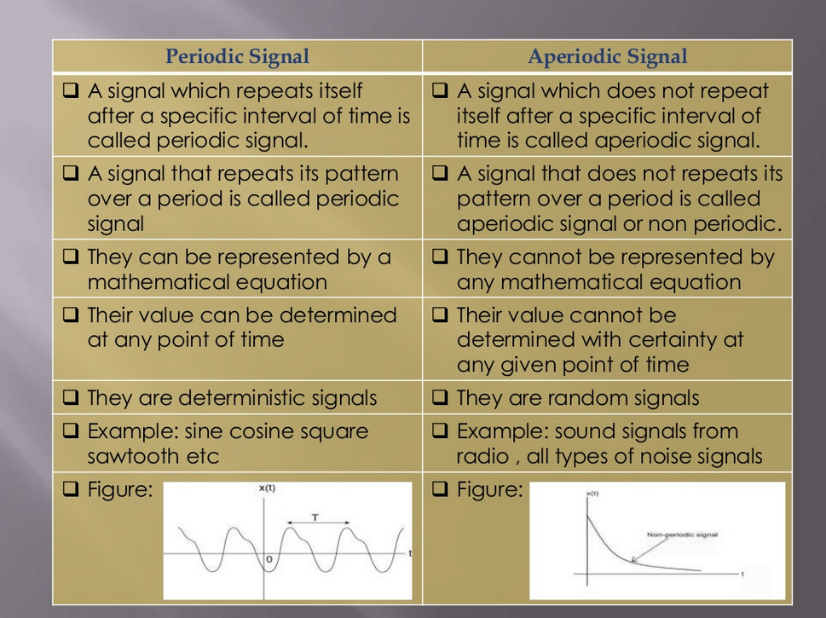

Slide 57

Figure 3.17 The time and frequency domains of periodic and nonperiodic
digital signals
3.<number>

Slide 58
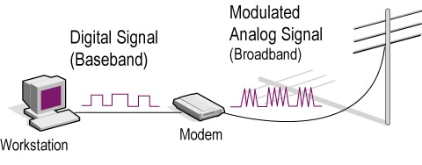
Baseband v/s Broadband
In the baseband transmission the whole bandwidth of the cable is utilized by a single signal.
Conversely, in the broadband transmission, multiple signals are sent on multiple frequencies simultaneously using a single channel.
3.<number>

Slide 59
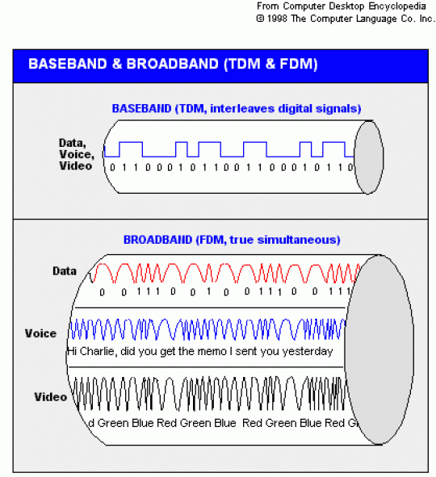
3.<number>

Slide 60

Figure 3.18 Baseband transmission
3.<number>

Slide 61

Figure 3.20 Baseband transmission using a dedicated medium
3.<number>

Slide 62
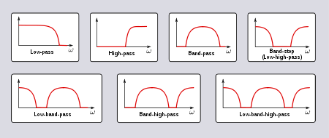
Low pass, Band pass & High pass filters
3.<number>

Slide 63
Note
Baseband transmission of a digital signal that preserves the shape of the digital signal is possible only if we have a low-pass channel with an infinite or very wide bandwidth.
3.<number>

Slide 64
Note
In baseband transmission, the required bandwidth is proportional to the bit rate;
if we need to send bits faster, we need more bandwidth.
In baseband transmission, the required bandwidth is proportional to the bit rate;
if we need to send bits faster, we need more bandwidth.
3.<number>

Slide 65

Table 3.2 Bandwidth requirements
3.<number>

Slide 66
Note
If the available channel is a bandpass channel, we cannot send the digital signal directly to the channel;
we need to convert the digital signal to an analog signal before transmission.
3.<number>

Slide 67

Figure 3.24 Modulation of a digital signal for transmission on a bandpass
channel
3.<number>

Slide 68
3-4 TRANSMISSION IMPAIRMENT
Signals travel through transmission media, which are not perfect. The imperfection causes signal impairment. This means that the signal at the beginning of the medium is not the same as the signal at the end of the medium. What is sent is not what is received. Three causes of impairment are attenuation, distortion, and noise.
Topics discussed in this section:
Attenuation
Distortion
Noise
3.<number>

Slide 69

Figure 3.25 Causes of impairment
3.<number>

Slide 70
Attenuation
Attenuation means a loss of energy.
When a signal, simple or composite, travels through a medium, it loses some of its energy in overcoming the resistance of the medium.
To show that a signal has lost or gained strength, engineers use the unit of the decibel.
The decibel (dB) measures the relative strengths of two signals or one signal at two different points.
3.<number>

Slide 71
Distortion
Distortion means that the signal changes its form or shape.
Distortion can occur in a composite signal made of different frequencies.
As a result, signal components at the receiver have phases different from what they had at the sender.
The shape of the composite signal is therefore not the same.
3.<number>

Slide 72
Noise
Noise is another cause of impairment.
Several types of noise, such as thermal noise, induced noise, crosstalk, and impulse noise, may corrupt the signal.
Thermal noise is the random motion of electrons in a wire, which creates an extra signal not originally sent by the transmitter.
Induced noise comes from sources such as motors and appliances. These devices act as a sending antenna, and the transmission medium acts as the receiving antenna.
Crosstalk is the effect of one wire on the other. One wire acts as a sending antenna and the other as the receiving antenna.
Impulse noise is a spike (a signal with high energy in a very short time) that comes from power lines, lightning, and so on.
3.<number>

Slide 73

Figure 3.26 Attenuation
3.<number>

Slide 74

Figure 3.28 Distortion
3.<number>

Slide 75

Figure 3.29 Noise
3.<number>

Slide 76


Figure 3.30 Two cases of Signal to Noise Ratio: a high SNR and a low SNR
3.<number>

Slide 77
3-5 DATA RATE LIMITS
A very important consideration in data communications is how fast we can send data, in bits per second, over a channel. Data rate depends on three factors:
1. The bandwidth available
2. The level of the signals we use
3. The quality of the channel (the level of noise)
Topics discussed in this section:
Noiseless Channel: Nyquist Bit Rate
Noisy Channel: Shannon Capacity
Using Both Limits
3.<number>

Slide 78
Note
Increasing the levels of a signal may reduce the reliability of the system.
3.<number>

Slide 79
Note
Increasing the levels of a signal may reduce the reliability of the system.
Two theoretical formulas were developed to calculate the data rate: one by Nyquist for a noiseless channel, another by Shannon for a noisy channel.
3.<number>

Slide 80

Data Rate Calculation
Nyquist
Shannon
Noiseless Channel
L = signal levels
Noisy Channel
SNR = signal to noise ratio
3.<number>

Slide 81
Example 3.34
Consider a noiseless channel with a bandwidth of 3000 Hz transmitting a signal with two signal levels. The maximum bit rate can be calculated as
3.<number>

Slide 82
Example 3.35
Consider the same noiseless channel transmitting a signal with four signal levels (for each level, we send 2 bits). The maximum bit rate can be calculated as
3.<number>

Slide 83
Example 3.37
Consider an extremely noisy channel in which the value of the signal-to-noise ratio is almost zero. In other words, the noise is so strong that the signal is faint. For this channel the capacity C is calculated as
This means that the capacity of this channel is zero regardless of the bandwidth. In other words, we cannot receive any data through this channel.
3.<number>

Slide 84
Example 3.38
We can calculate the theoretical highest bit rate of a regular telephone line. A telephone line normally has a bandwidth of 3000. The signal-to-noise ratio is usually 3162. For this channel the capacity is calculated as
This means that the highest bit rate for a telephone line is 34.860 kbps. If we want to send data faster than this, we can either increase the bandwidth of the line or improve the signal-to-noise ratio.
3.<number>

Slide 85


Example 3.40
For practical purposes, when the SNR is very high, we can assume that SNR + 1 is almost the same as SNR. In these cases, the theoretical channel capacity can be simplified to
For example, we can calculate the theoretical capacity of the previous example as
3.<number>

Slide 86
Example 3.41
We have a channel with a 1-MHz bandwidth. The SNR for this channel is 63. What are the appropriate bit rate and signal level?
Solution
First, we use the Shannon formula to find the upper limit.
3.<number>

Slide 87
Example 3.41 (continued)
The Shannon formula gives us 6 Mbps, the upper limit. For better performance we choose something lower, 4 Mbps, for example. Then we use the Nyquist formula to find the number of signal levels.
3.<number>

Slide 88
Note
The Shannon capacity gives us the upper limit; the Nyquist formula tells us how many signal levels we need.
3.<number>

Slide 89
3-6 PERFORMANCE
One important issue in networking is the performance of the network—how good is it? We discuss quality of service, an overall measurement of network performance, in greater detail in Chapter 24. In this section, we introduce terms that we need for future chapters.
Topics discussed in this section:
Bandwidth
Throughput
Latency (Delay)
Bandwidth-Delay Product
3.<number>

Slide 90
Performance
Bandwidth: a range of frequencies within a given band, in particular that used for transmitting a signal.
Throughput: the amount of bits passing through a system or process at given time.
Latency (Delay): the total time it takes a data packet to travel from one node to another.
Bandwidth-Delay Product: the product of a data link's capacity (in bits per second) and its round-trip delay time (in seconds).
3.<number>

Slide 91
Note
In networking, we use the term bandwidth in two contexts.
❏ The first, bandwidth in hertz, refers to
the range of frequencies in a
composite signal or the range of
frequencies that a channel can pass.
❏ The second, bandwidth in bits per
second, refers to the speed of bit
transmission in a channel or link.
3.<number>

Slide 92

Figure 3.31 Filling the link with bits for case 1 Frequency Based. FDM
3.<number>

Slide 93

Figure 3.32 Filling the link with bits in case 2 Time Based. TDM
3.<number>

Slide 94
Note
The bandwidth-delay product defines the number of bits that can fill the link.
3.<number>

Slide 95

Figure 3.33 Concept of bandwidth-delay product
3.<number>

Slide 96
THANK YOU
Develop your skills in designing networks
3.<number>

